Slide 1
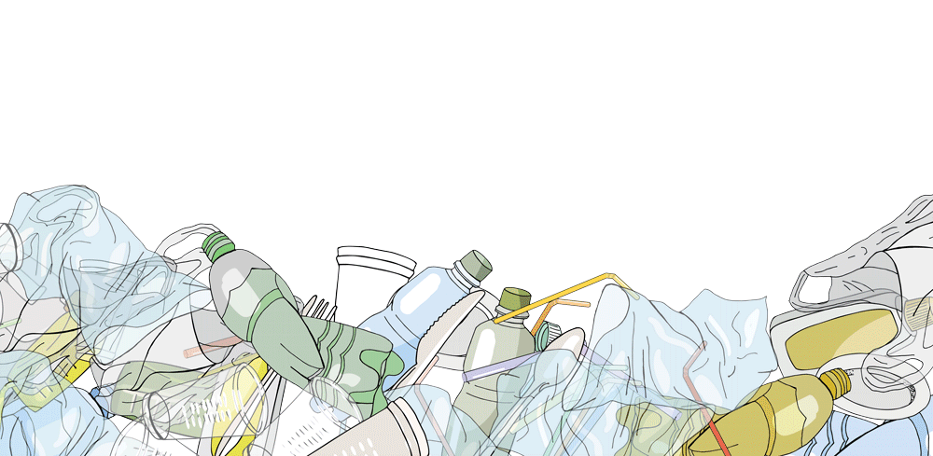
The Basics of the Plastic Pollution Reduction Act of 2021
What is it and how will it affect you?
Randy Moorman
Legislative and Community Campaigns Director
Eco-Cycle

Slide 2
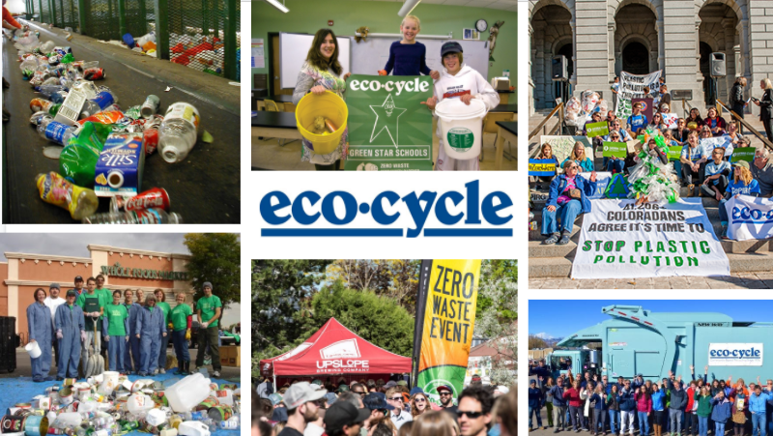

Slide 3
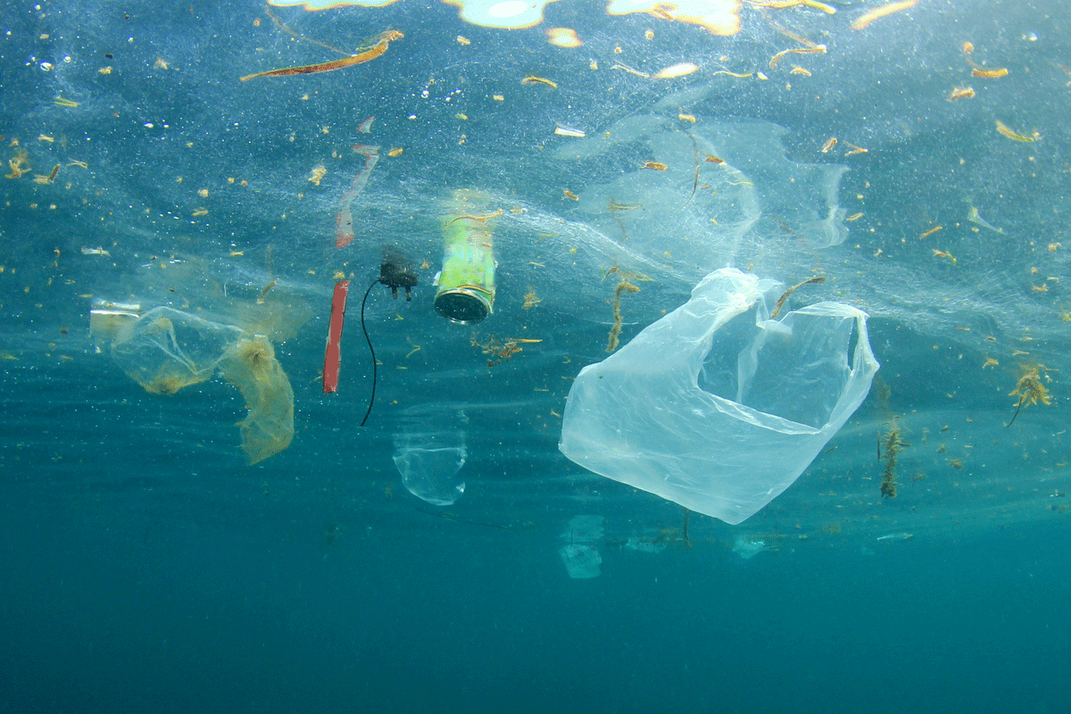
PLASTICS
ONLY 9%
OF ALL PLASTICS have been recycled
MORE PLASTIC
in the ocean than fish by 2050
PLASTIC PRODUCTION WILL
QUADRUPLE
by 2050
Notes:
Today, we’re talking about how to reduce plastic pollution through federal and state policy. I’m going to start by saying something I think everyone already knows, and that is we can’t recycle our way out of our plastics pollution problem. Plastic production has exploded from 2 million tons annually in 1950 to more than 440 million tons in 2015 and it is expected to quadruple in the next 30 years. We have created 8.3 billion metric tons of plastic, of which 6.3 billion metric tons in now plastic waste in our oceans, littering landscapes and floating in our rivers or sitting in our landfills. We’ve only recycle 9% of the plastic that has ever been produced. If we don’t break this trend, it is estimated that by 2050 there will be more plastic in the ocean than fish by weight.

Slide 4
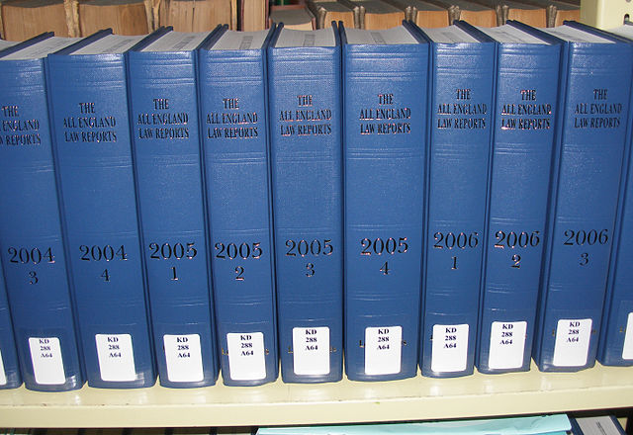
Pre-emption
C.R.S. 25-17-104
Local Government Preemption (1993)
No unit of local government shall require or prohibit the use or sale of specific types of plastic materials or products or restrict or mandate containers, packaging, or labeling for any consumer products.
Notes:
Now, the other issue we faced was state law. Colorado communities can’t legally outright ban the use of plastics because of this statute, that was passed in 1993. It specifically preempts local governments from restricting plastic packaging.

Slide 5
STATES WITH PLASTIC PRE-EMPTION LAWS
Notes:
Colorado isn’t alone. There are 13 states with similar pre-emption language (currently NM is not one of them, but beware, the plastics industry is trying hard to get more states to adopt pre-emption laws!). While, three other Colorado communities had gone before Boulder, Telluride, Aspen and Carbondale and they ignored this state law and banned plastic bags, Boulder’s city attorneys worried that they would be a target to a law suit if they tried to ban plastic bags.

Slide 6
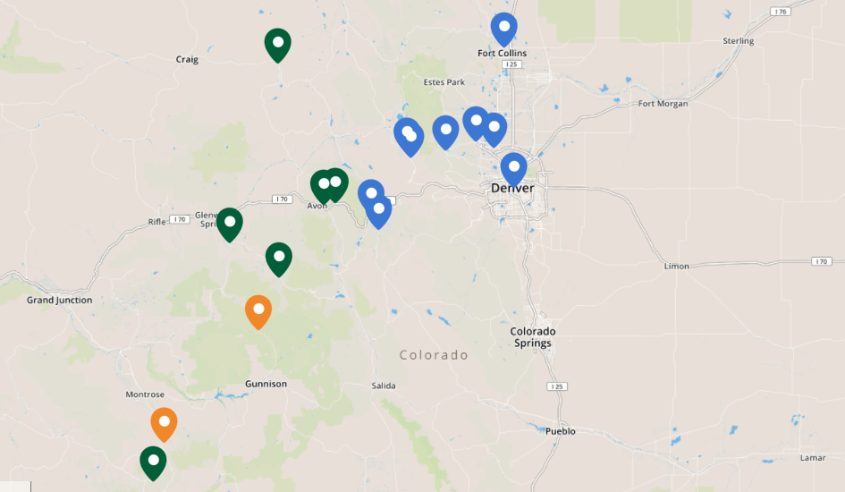
Map of Colorado Communities with Bag Ordinances
Notes:
Since Boulder’s bag fee ordinance in 2012, 13 more Colorado communities have passed bag ordinances, including most recently the cities of Louisville and Fort Collins which both did it by voter approved ballot measures. This brings us to a total of 17 Colorado communities, making Colorado a leader in non-coastal states in taking action to reduce disposable plastics.

Slide 7
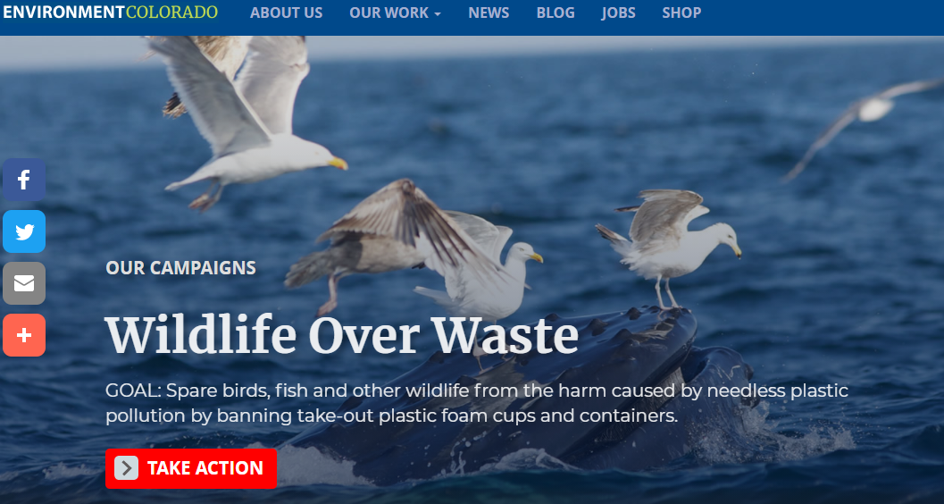
Notes:
Now, until two years ago, nothing had happened at the state level regarding plastic waste. But there was momentum building. Of course, nationally, since the 2015 photo of the straw in the turtles nose went viral and plastic pollution became more and more in the media spotlight, Coloradans were paying attention. In 2018 Environment Colorado launched their Wildlife Over Waste campaign, asking Coloradans to sign a petition to ban polystyrene food grade foam take out containers. They got over 41,000 signers on their petitions from canvassing. They asked us to help them write a bill and in 2019 we introduced SB19-243 - the Prohibition of Food Establishments use of Polystyrene. That year, the bill didn’t get a vote in the senate chamber, we ran out of time after a late start.

Slide 8
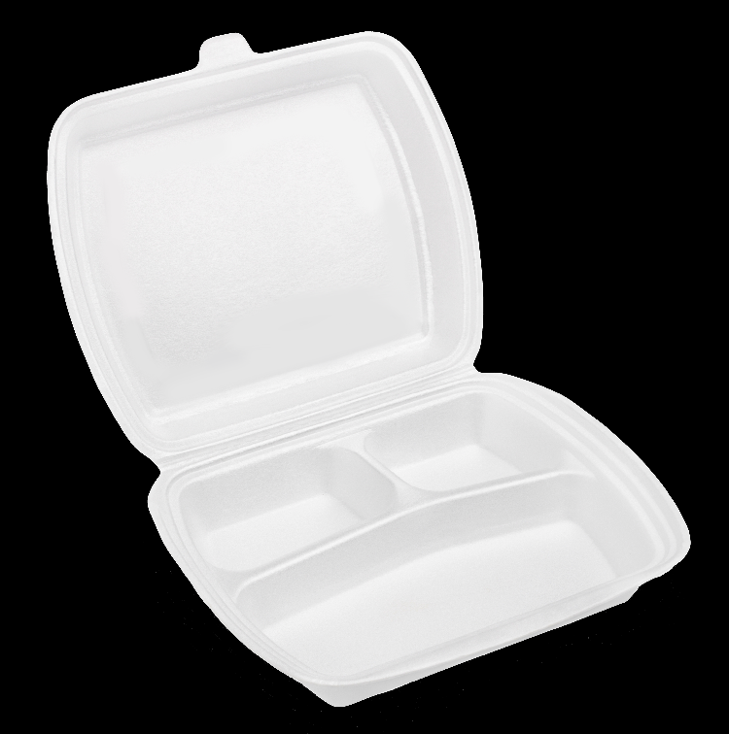
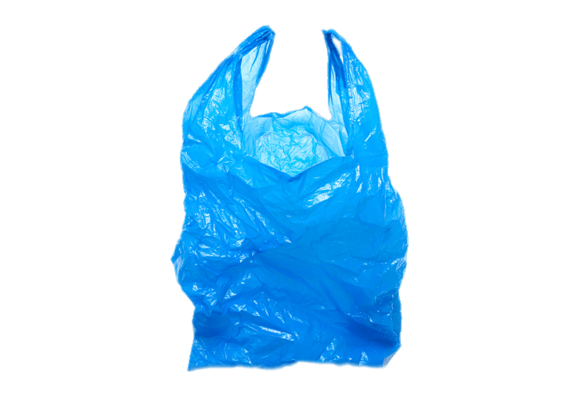
2020
SB20-010
Repeals the ban on local governments regulating plastics
HB20-1163
Bans plastic bags and stirrers
Places a fee on paper bags
Requires straws upon request
HB20-1162
Bans polystyrene take out containers and cups
Notes:
Last year, we even had more interest from legislators and had three plastic pollution-related bills. One, was to remove the state ban on local governments regulating plastics or pre-emption. A second, was a repeat of the polystyrene ban we had in 2019 and a third dealt with bags, modeling after the hybrid model we were seeing around the country - a ban on plastic bags with a fee on paper bags. It also included a ban on plastic stirrers and required straws upon request at restaurants. Now, we found having three bills became a detriment to the cause. The opposition/industry, was using the different bills to divide legislators and it worked. Legislators were picking and choosing which bill they would support. While the Democrats have control of both chambers, they only had a 3 seat advantage in the senate. So, some vulnerable senators were only willing to go out on a limb and vote for one bill. This made it extremely hard to pass any of the three bills The pre-emption bill, SB21-010 died in its first committee and the other two bills were lost because they ran out of time, they weren’t seen as priority bills with COVID.

Slide 9
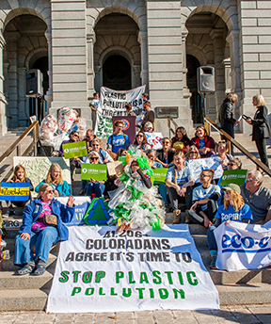
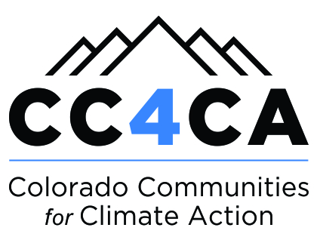
2021 - Plastic Pollution Reduction Act
Remove pre-emption and allow local communities to have control on plastic pollution
Ban plastic bags statewide and charge a fee on paper bags
Ban polystyrene food containers statewide
Notes:
That brings us to this year. We put together a coalition of groups including Environment Colorado, COPIRG, Conservation Colorado, Sierra Club, Inland Ocean Coalition, 350.org, and Green Lations. We decided to combine all three legislative concepts into one bill, to simplify our messaging and make it harder for the opposition to make legislators pick and choose which bill they will support. We included the removal of pre-emption, or the ban on local communities because we knew some communities wanted to do more than just get rid of bags and polystyrene. Some want to regulate utensils, straws, condiment packets. As a result, the opposition (retail association, restaurant association, beverage association, american chemical council) has come to realize that the bill has momentum and they can’t defeat it. What they instead ended up doing, is targeting one piece of it - they really hate removing pre-emption. They have presented this doomsday scenario that the sky will fall if pre-emption is removed - it will create this patchwork headache for them of different regulations from community to community. I find it interesting that in a state like NM, where you don’t have a pre-emption law, or in 37 other states without it, the sky hasn’t fallen. But that has been the one piece that they can’t seem to live without and what they have done is gotten legislators to remove it by saying they will go neutral on the bill with it out. Which isn’t the position they had last year, they were just opposed to all the bills.

Slide 10
Keys to success
Built momentum with grassroots pressure
Worked traditional and social media
Coalesced around single message
Perseverance
Partnered with green business community
Engaged kids as the spokespersons
Notes:
Momentum - I mentioned earlier how Env CO had canvassed and gathered 41,000 signatures. We also, through our coalition of organizations, had Coloradans contact their legislators. We had also several lobby days and virtual lobby days this year where more than 400 Coloradans had participated in meetings with their legislators. This was especially important after the 2020 elections and we had new members coming in. As a result, the Democrat Caucus in both chambers prioritized our bill.
Traditional and social media - we continue to work the media and get stories about the issue, get folks to write LTEs to their local newspapers throughout the state and of course use social media, FB and Twitter tagging legislators
Single message - was key this year, with having just one bill - we have a plastic pollution problem in the state (we brought it home - raining plastic on RMNP and plastic bags are the number one item collected in river clean ups) and we have a solution, the Plastic Pollution Reduction Act.
Perseverance through three years of work - and a pandemic!
Good Business CO - great to have their voice - bringing restaurants to testify saying it isn’t that hard to switch out polystyrene food containers, alternatives are getting more price competitive. Their customers are expecting it.
Biggest asset this year has been the kids - we now had two kid or youth only lobby days, they show up to testify and we will be doing a youth only press conference soon for our first hearing in the senate. They are the future and they have a LOT to say about plastic pollution. You can’t underestimate the power of their voice.

Slide 11
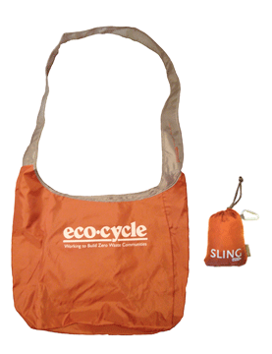
Bag Fees
Beginning Jan. 1, 2023 - $0.10 fee on plastic and paper carryout bags
Affects large grocery and retail stores
Restaurants and small Colorado-only stores with 3 or fewer locations excluded
Retailer keeps $0.04 to implement the program
Municipalities and Counties (unincorporated) receive $0.06 to implement program, enforce the law, fund recycling, composting, waste diversion programs, and education
Does not apply to customers with federal or state food assistance programs
Fee on plastic bags ends Jan. 1, 2024

Slide 12
Notes:
So, Eco-Cycle really started working on plastic pollution policy in 2011 when a bunch of students from Fairview High School came to City Council and made the case that the city should ban plastic bags. We offered our help to develop the policy. Based on what we knew from other communities around the country, we first recommended that the policy address both paper and plastic bags, since communities that only banned plastic bags saw an uptick in the use of paper bags as a result and paper bags have their own environmental impacts as illustrated here in one of our campaign ads.

Slide 13
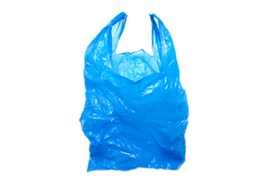
Bag Ban
Beginning Jan. 1, 2024 – Ban plastic carryout bags
Affects large grocery and retail stores
Restaurants and small Colorado-only stores with 3 or fewer locations excluded
Stores can use up any remaining stock of bags until June 1, 2024 as long as they were purchased by Jan. 1, 2024.

Slide 14
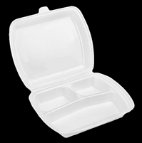
Polystyrene Ban
Beginning Jan. 1, 2024 – Ban polystyrene food containers and cups
Affects all restaurants and schools
Retail food establishments can use up any polystyrene containers purchased by Jan. 1, 2024 until they are gone

Slide 15
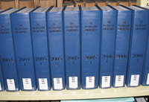
Removal of Pre-emption
Beginning July. 1, 2024 – municipalities and counties can enact, implement and enforce more stringent laws
Local governments can enact and enforce laws that prohibit, restrict or mandate the use or sale of plastic materials, containers, packaging or labeling
Exempts packaging for medical products including drugs, medical devices or dietary supplements

Slide 16
Enforcement
Left to local governments
May enforce violations in the manner that the local government chooses
Counties may seek injunctive relief against the violating restaurant or store up to $500 for second violation and up to $1000 for a third or subsequent violation
Counties may also impose a civil penalty against violators
Exempts schools from enforcement

Slide 17
Questions & Next Steps
Randy Moorman
Director of Legislative and Community Campaigns
Eco-Cycle
randy@ecocycle.org
Future workshop on going beyond bags and polystyrene

