Slide 1
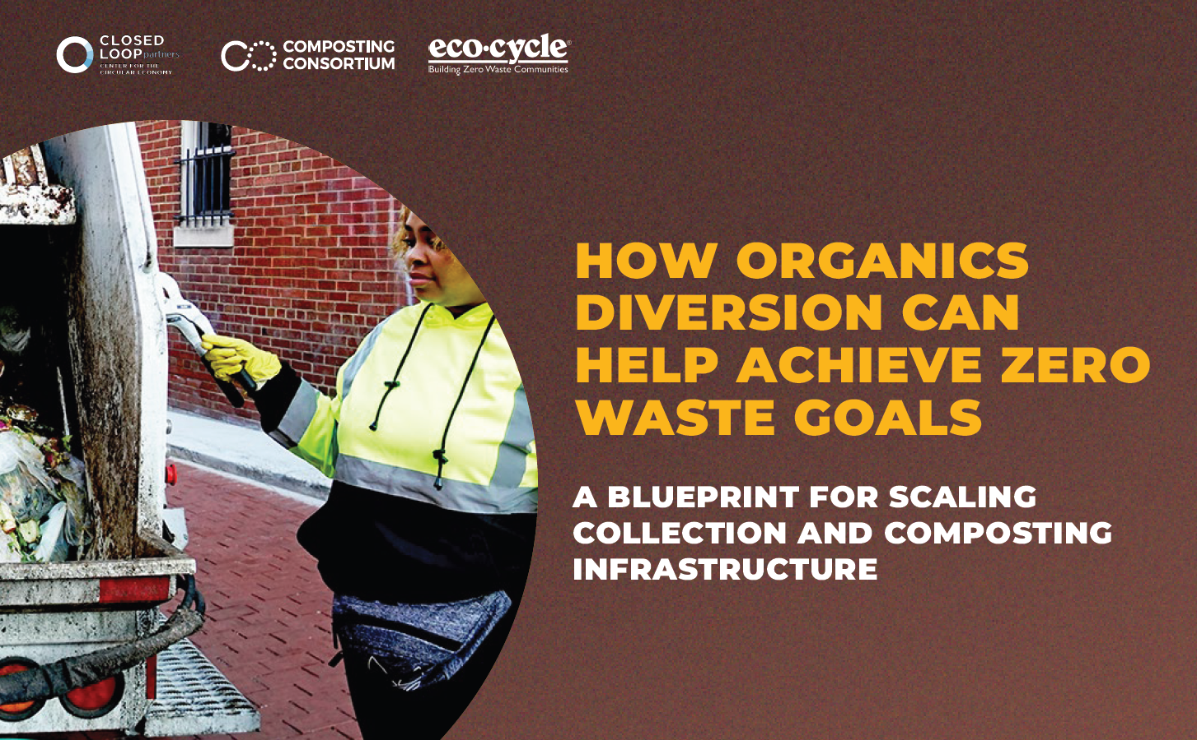
Notes:
Links:
Toolkit: https://www.closedlooppartners.com/research/municipal-blueprint-report/
Outreach resources: https://www.closedlooppartners.com/compost-sign-download/

Slide 2
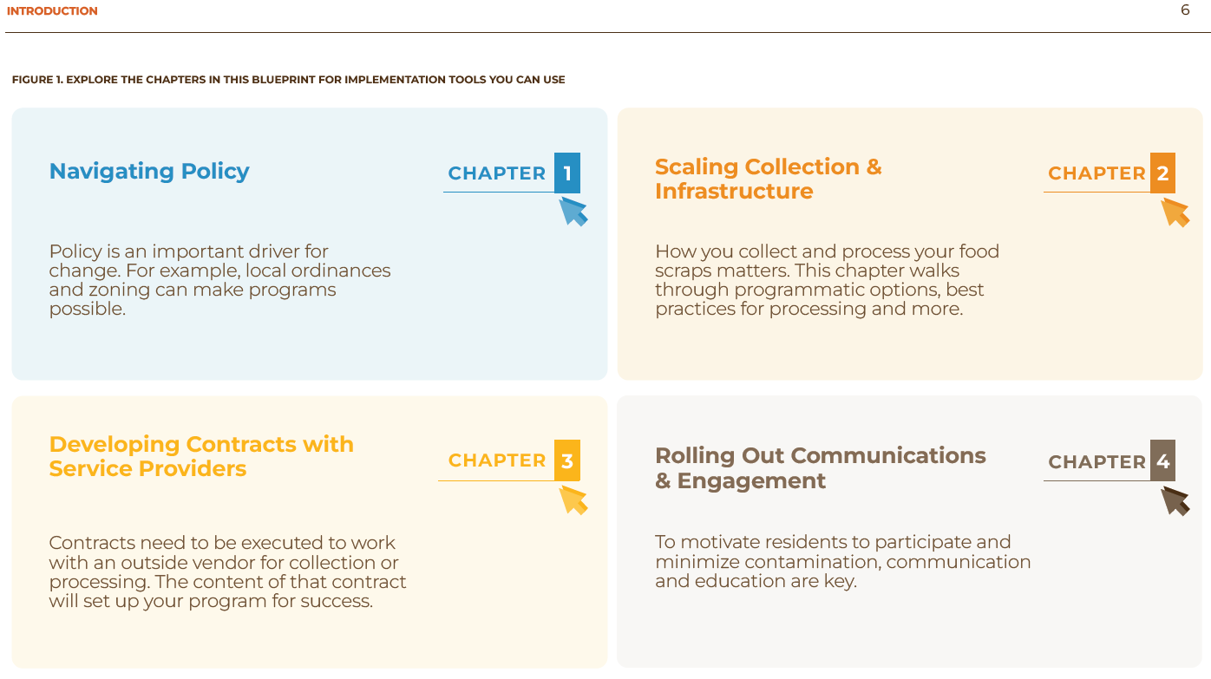

Slide 3
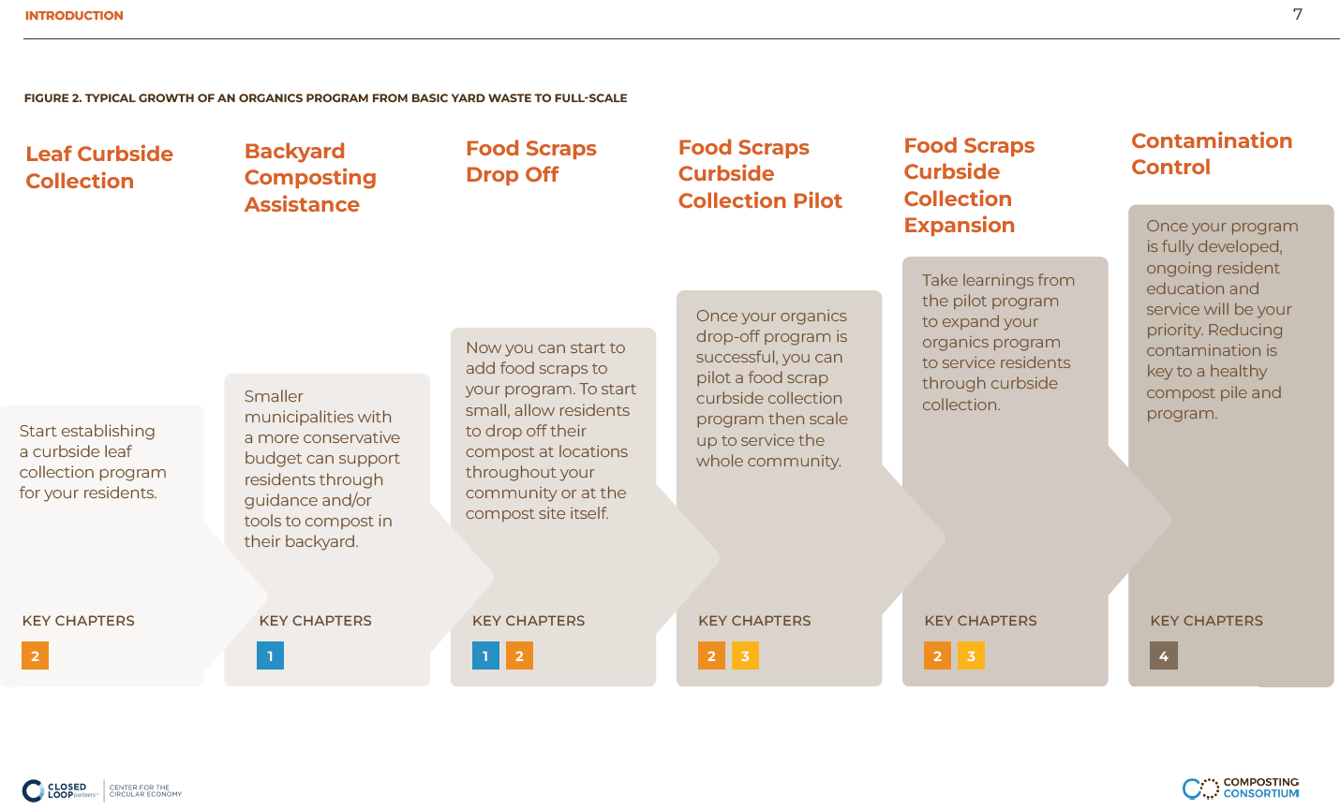

Slide 4
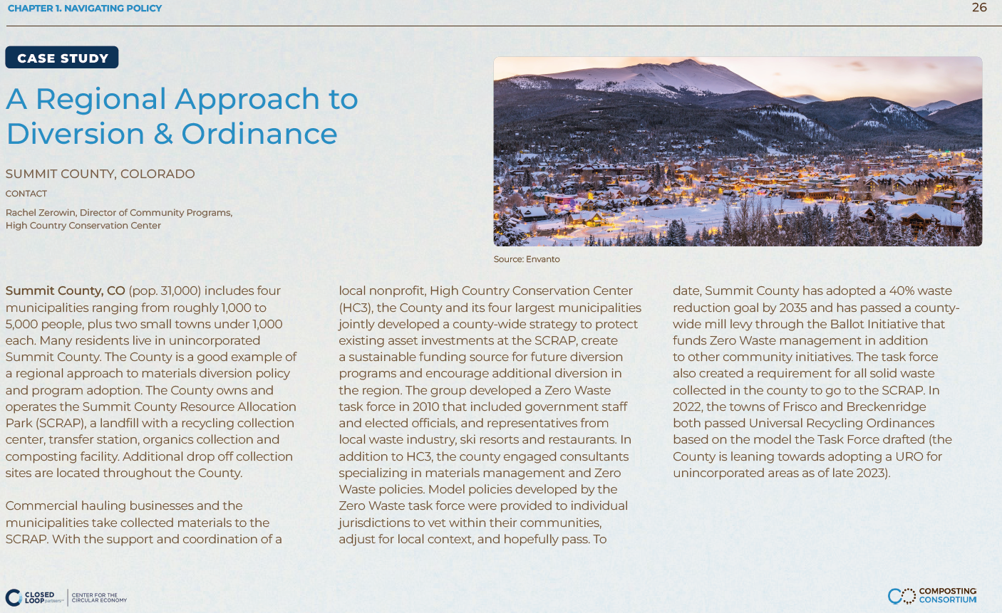

Slide 5
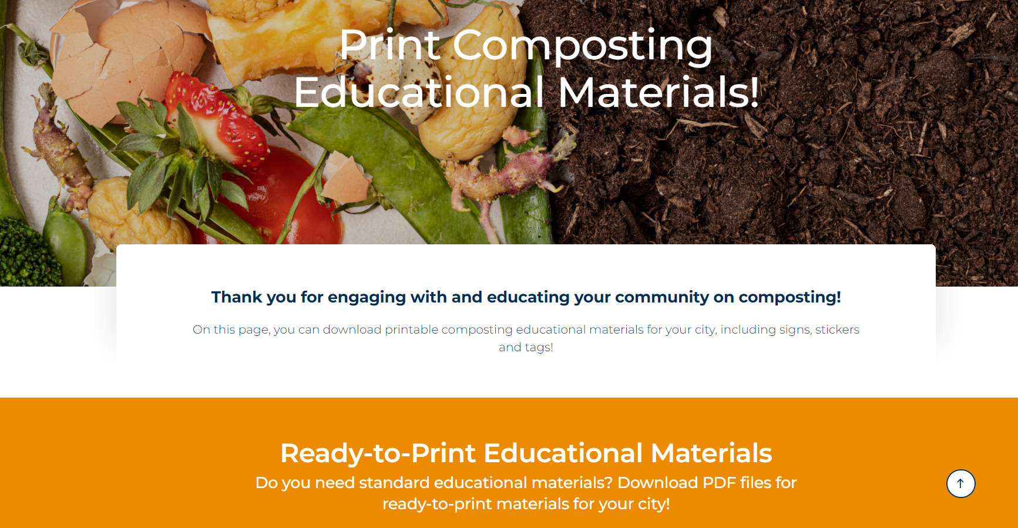

Slide 6
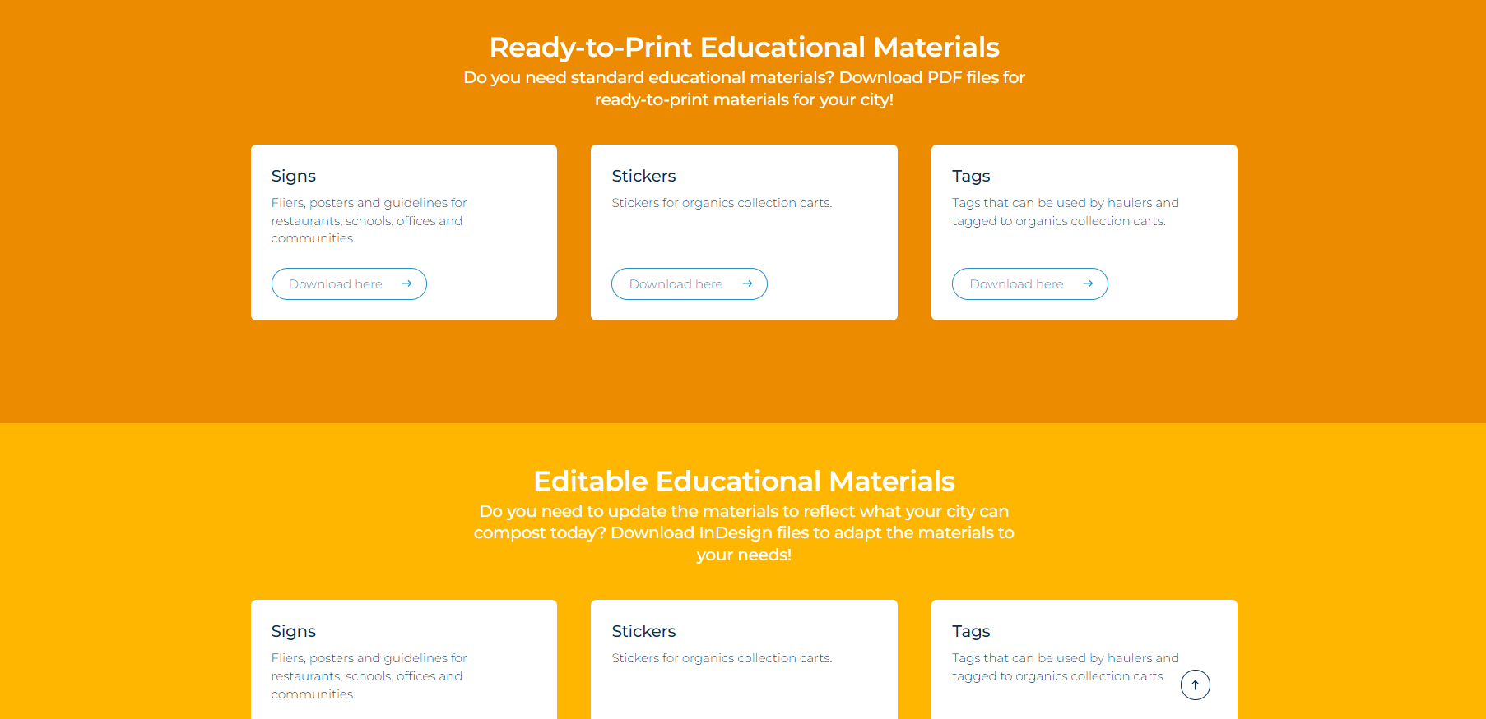
Notes:
Links:
Toolkit: https://www.closedlooppartners.com/research/municipal-blueprint-report/
Outreach resources: https://www.closedlooppartners.com/compost-sign-download/

Slide 7
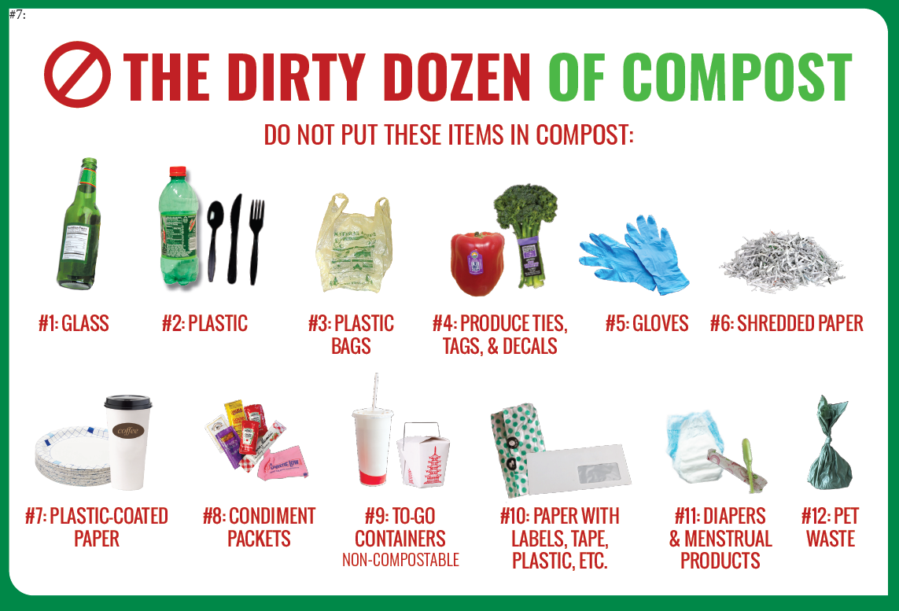
Customizable outreach materials

Slide 8
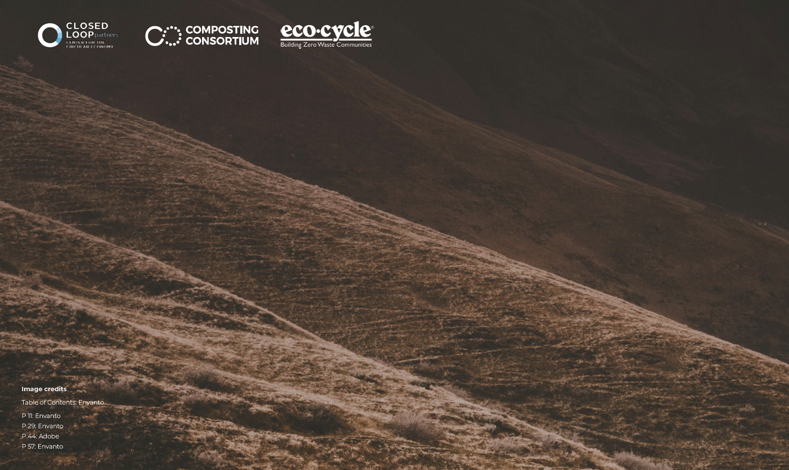
Learn More
Eco-Cycle Blog: ecocycle.org
Toolkit: closedlooppartners.com/research/municipal-blueprint-report
Outreach resources: closedlooppartners.com/compost-sign-download
Notes:
Eco-Cycle Blog: www.ecocycle.org
Toolkit: https://www.closedlooppartners.com/research/municipal-blueprint-report/
Outreach resources: https://www.closedlooppartners.com/compost-sign-download/

